Slide 1
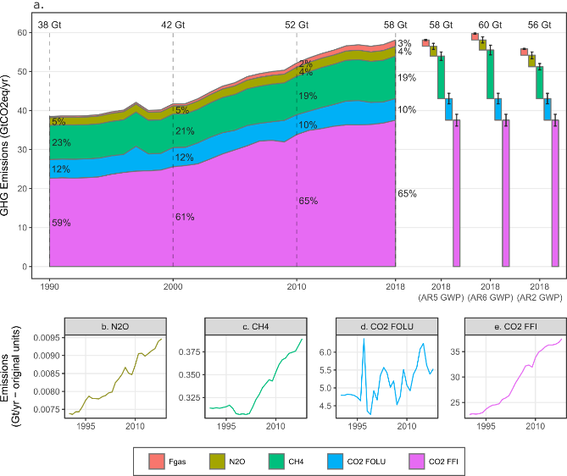
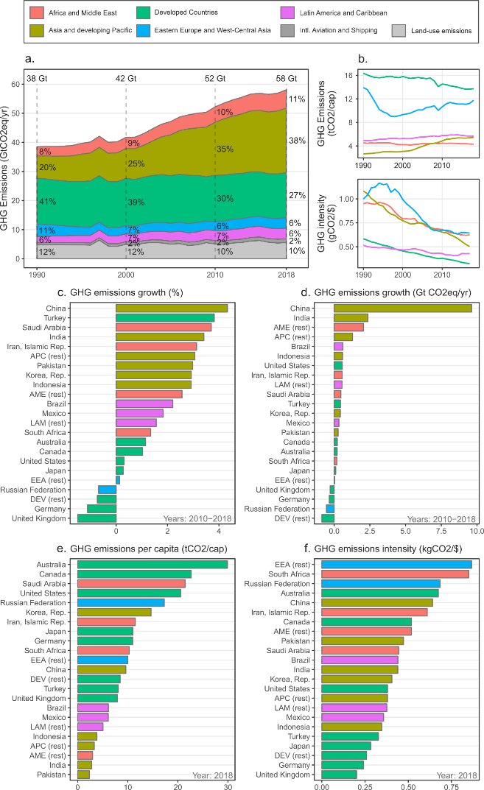
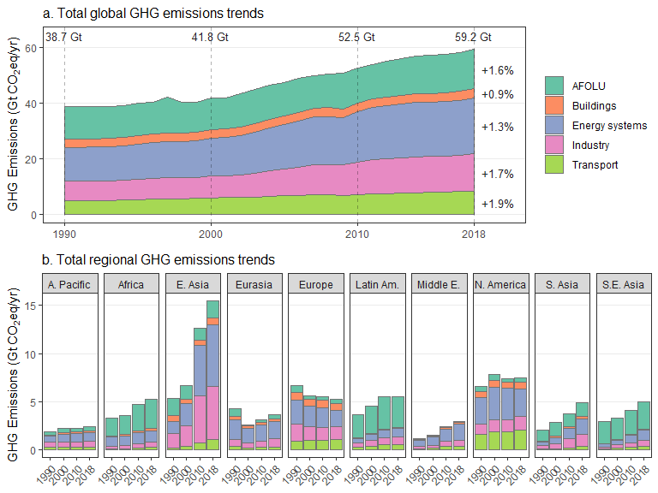
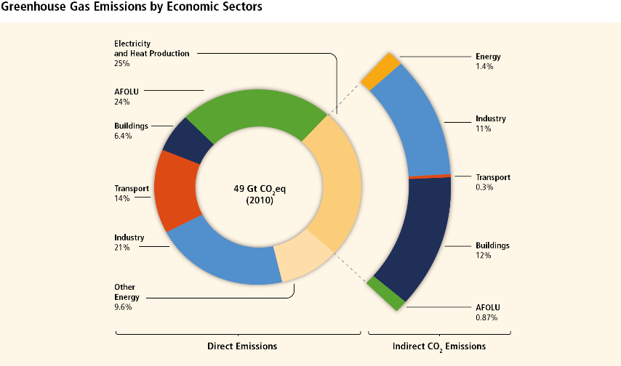
Technical Summary figures (current)
Total GHGs
GHGs by region
GHGs by sector
Direct / indirect emissions
- Alternative self-explanatory format?

Slide 2
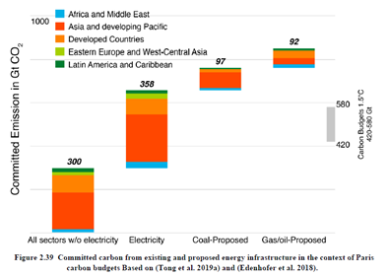
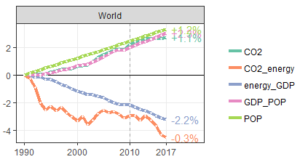
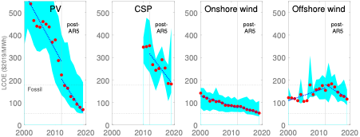
Technical Summary figures (current)
Committed carbon
Kaya decomposition of drivers
- Also include regions
Cost declines in key technologies

Slide 3
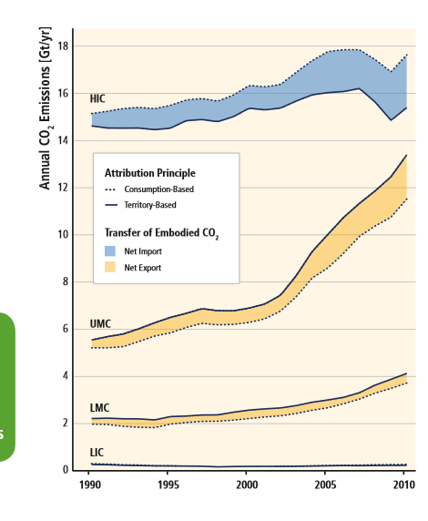
New figures to propose
Consumption based emissions by regions ->
COVID emissions decline ?
No consensus for inclusion

Slide 4
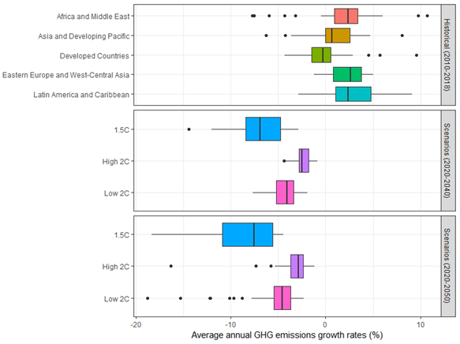
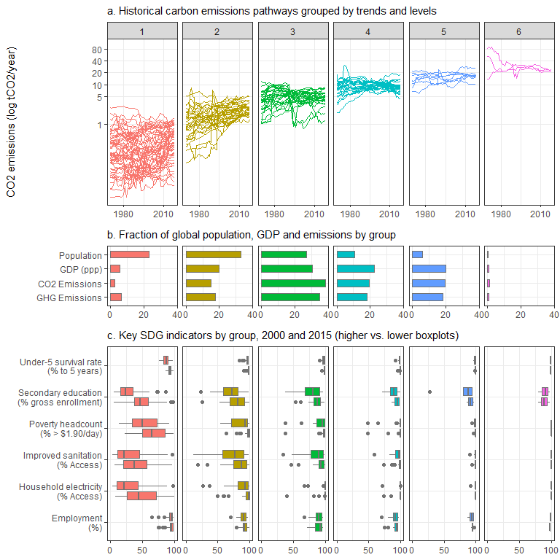
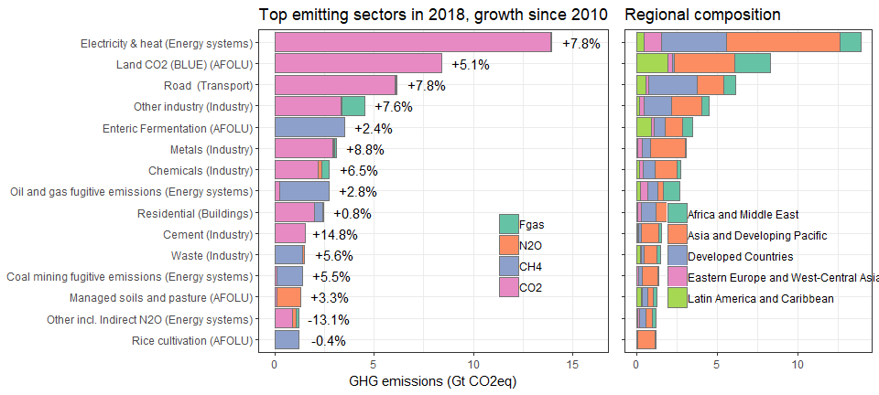
New figures to propose
Benchmarking historical reduction rates
From section 2 & 4.1 (Jan and Will)
CO2 emissions pathways and SDGs
Highest emitting subsectors

